Slide 1

Carbon Neutrality Intelligence
in Electricity Industry
Zero Carbon ，For Our Earth
Yajie Jin, Zhaoyi Zhang, Boyang Chen,
Qinhan Yu, Xiaoran Wu, and Wendi Qiu
Nankai University
C + - Co., Ltd
2022.01.20
1

Slide 2
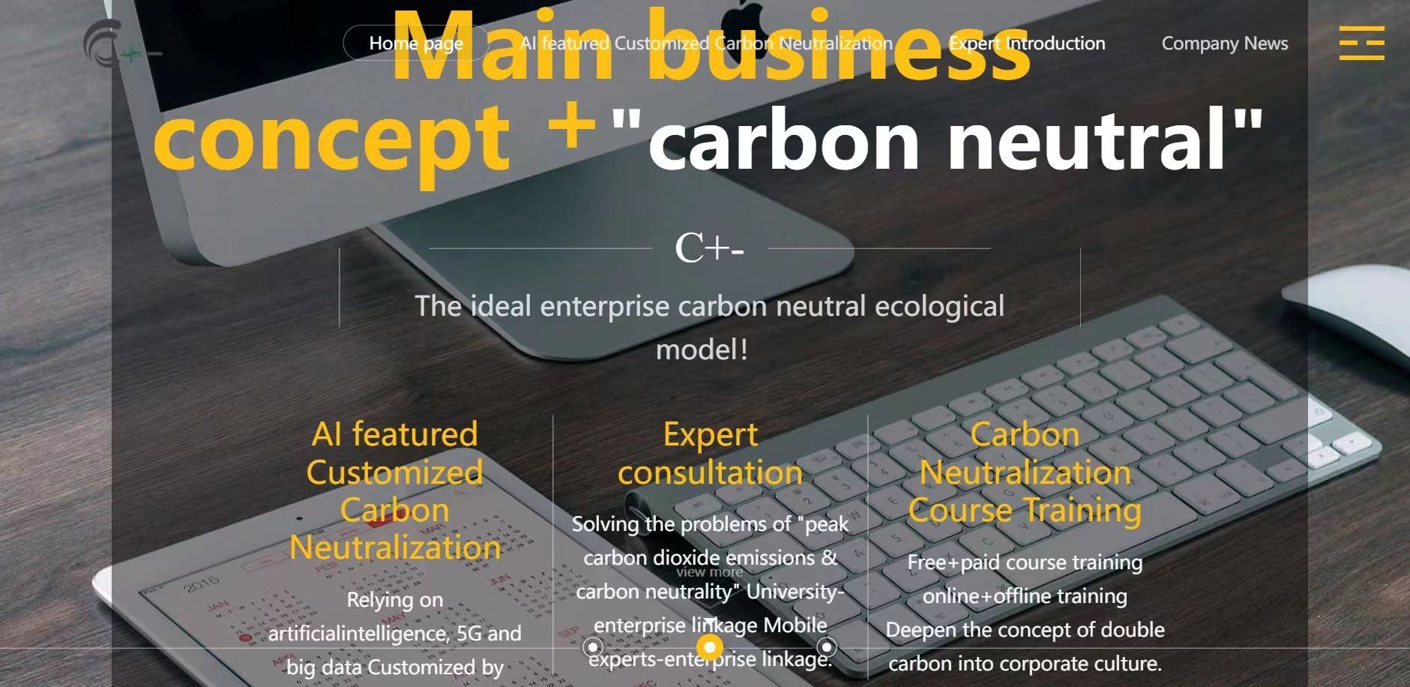
Goals
Industry Situation
Global Warming
Intellectual Support
Political
×
Economic
×
Social
×
Technological
C + - Co., Ltd
Electricity Industry
Community
AI featured customized carbon neutralization plan
Carbon minus coin Project
C+- Platform Web
Ecological Benefits
Economical Benefits
^{Intelligent}
Cost-Effective
Customized
2

Slide 3
1
Background
2
Market and Customers
Outline
3
Solution
4
Business Analysis
5
Development Program
3

Slide 4
PART 1
Background
4

Slide 5

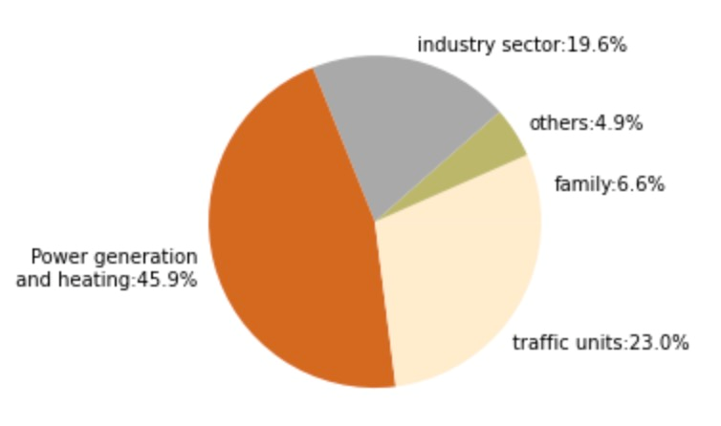
Backgroud-
Global Warming
Current Situation
China's double carbon commitment : Achieving carbon peak by 2030 and carbon neutralization by 2060.
Thermal power is the main power generation mode in China, but its pollution situation is not optimistic
Due to the influence of energy structure and historical factors, the domestic power supply structure will still be dominated by thermal power for a long time.
Power Generation & Heating are the industries with the largest carbon emissions in China.Its emissions reduction is critical to this goal.
China's "double carbon" commitment puts forward new requirements for transformation and upgrading of thermal power industry
5

Slide 6

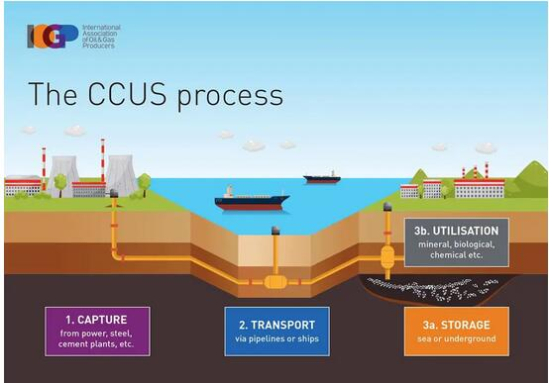
Backgroud-
Existing technology of electricity industry
r
Carbon trading
The problem of cross-regional transactions
No regional total carbon emission target
CCUS technology
The limitation of cost and technology
6

Slide 7
PART 2
Market and Customers
7

Slide 8
Market&Customers-
STP Analysis
Marketing Plan
charge a certain fee for making a full set of plans in the later stage.
Targeting
Segmentation
Adopt flexible pricing strategy
Positioning
First— seize the market share of thermal power generation in East, North and northwest China and its key cities.
After—expand the scale of user groups and gradually spread products to major cities through the innovation of technology and the improvement of platform services.
Market positioning - product specialization, customization, provide follow-up process services, high quality and high price.
Provide follow-up service for the users, expand the diversity of services and increase the source of income.
Arouse users' trust in the product and strengthen users' recognition of the company's expert team with a high price.
Different regions and cities have different degrees of thermal power generation technology renewal, pollution, production capacity and energy efficiency, so differentiated customized services should be carried out.
8

Slide 9

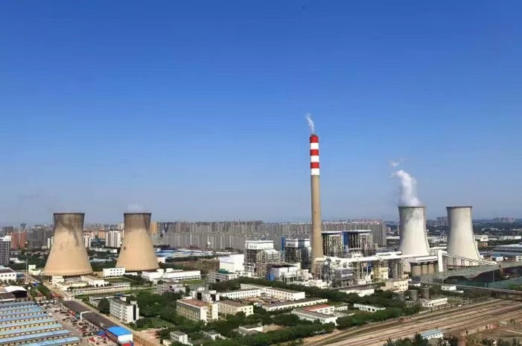
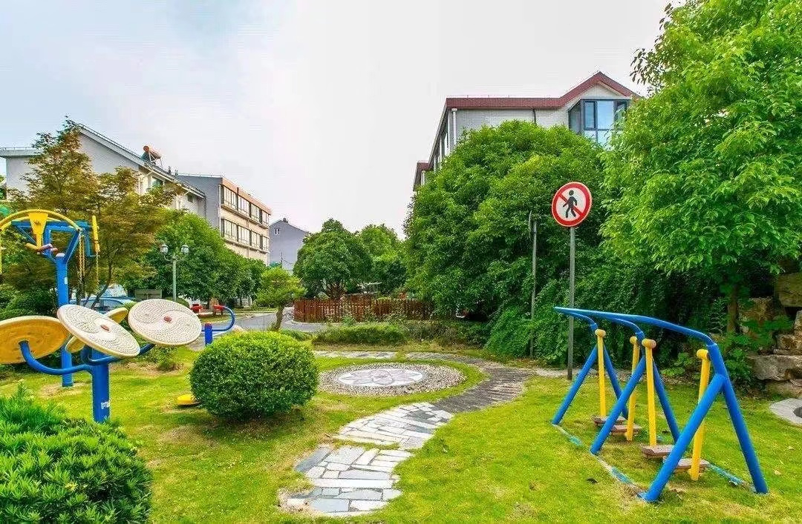
Market&Customers-
Target Population
Our Customers
Target population:
The leaders, employees and their communities of intelligent thermal power industry enterprises. It can be gradually extended to more communities, which will involve students, housewives and so on.
Crowd characteristics:
Whose enterprise has high carbon emissions
Whose factory has or needs intelligent technology
Use mobile phones
9

Slide 10
PART 3
Solution
10

Slide 11

Solution-
About us
C, refers to carbon, recycling, environmental protection.
+, consists of two seedlings, which means "peak carbon dioxide emissions" , and refers to internet plus.
-, which means reduce carbon emissions
Corporate Name
Tianjin C+- limited liability company
Zero carbon，for the earth .
Corporate Mission
Products&Services
C+- platform
11
PPT下载 http://www.1ppt.com/xiazai/

Slide 12
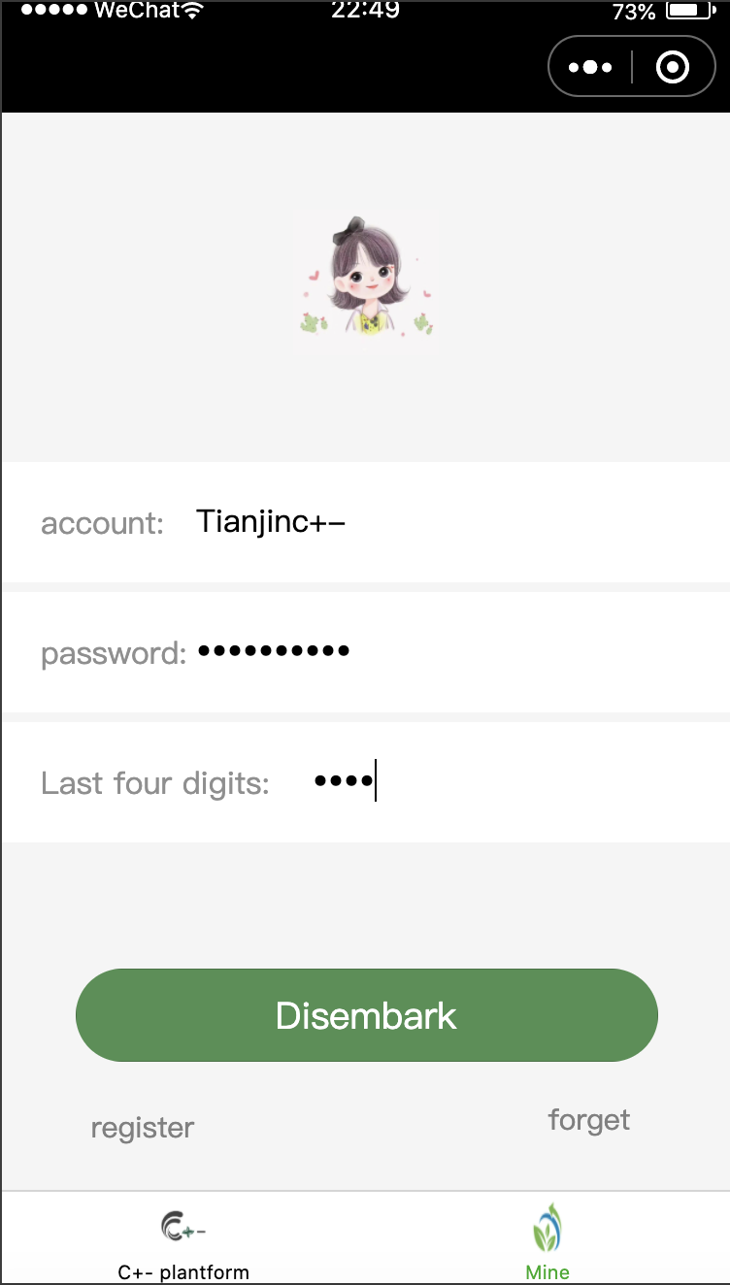
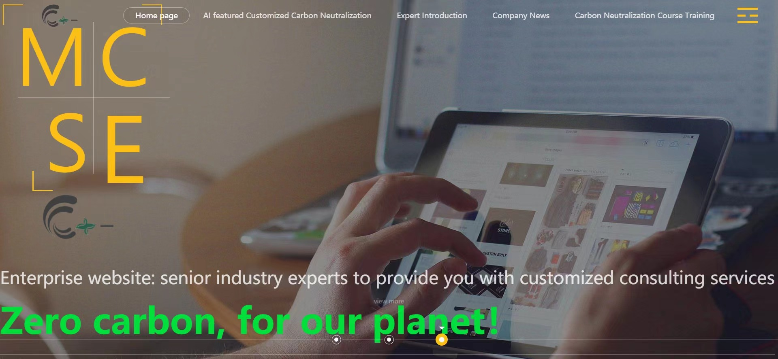
Solution-
C+- Platform
Name
Features
Function
C+- platform
Dynamic & Customized
AI featured customized carbon neutralization plan
& Carbon minus coin Project
Account management system
12

Slide 13
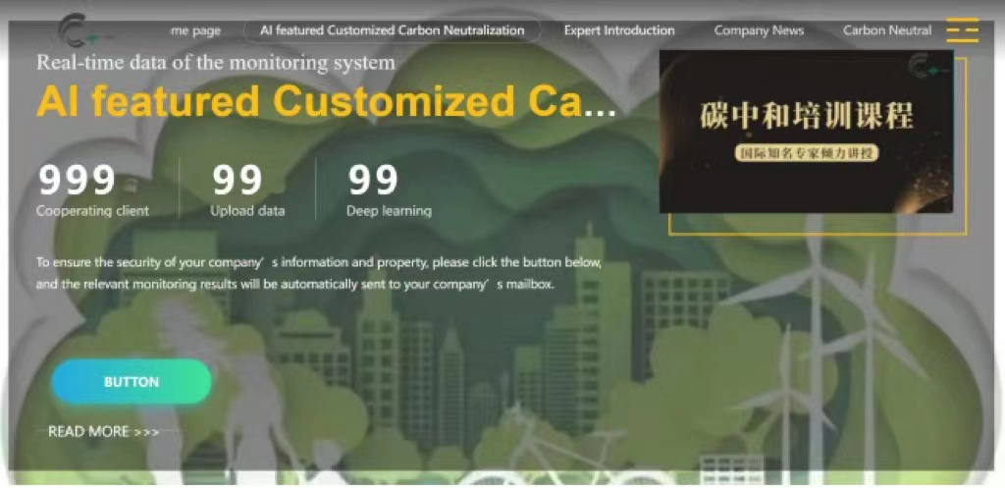
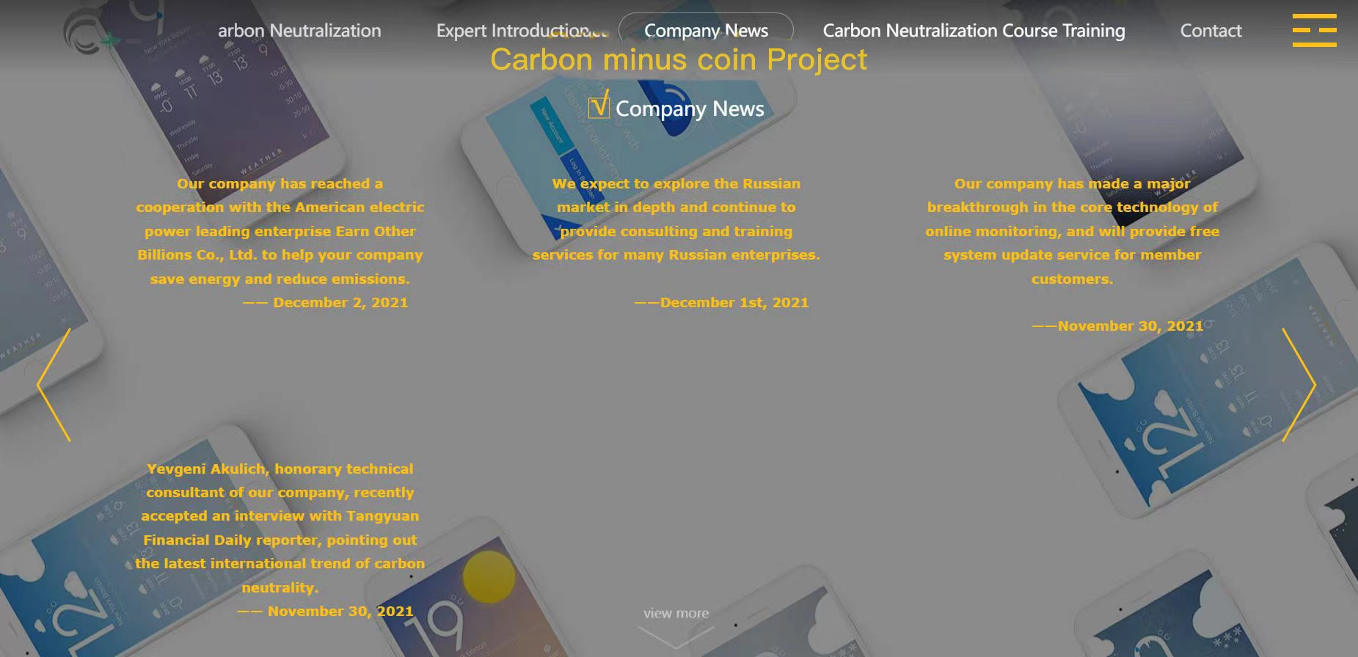
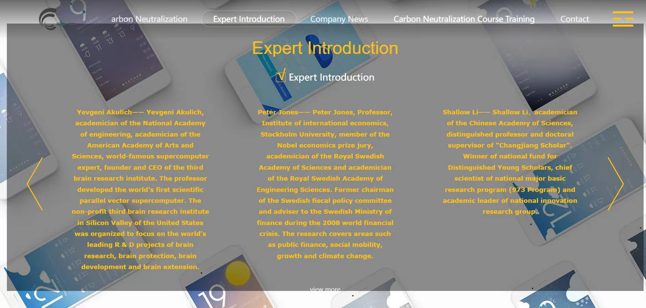
Solution-
Module of product
Module 01
Module 02
AI featured customized carbon neutralization plan
Carbon minus coin Project
Dynamic monitoring system
Carbon emission reduction plan
Deep learning & Frontier technology
Training services
Expert consultation
Solving problems of carbon neutrality
Customized & Professional
13

Slide 14
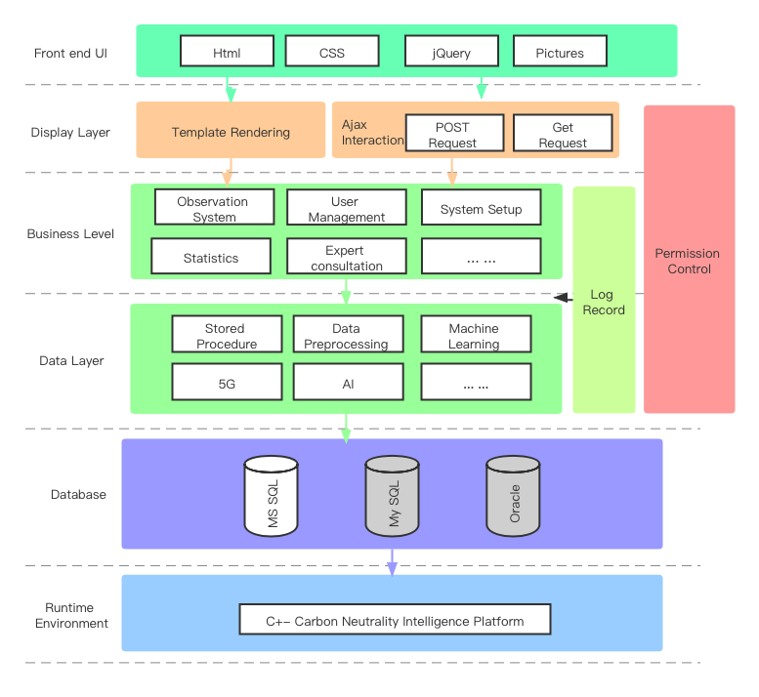
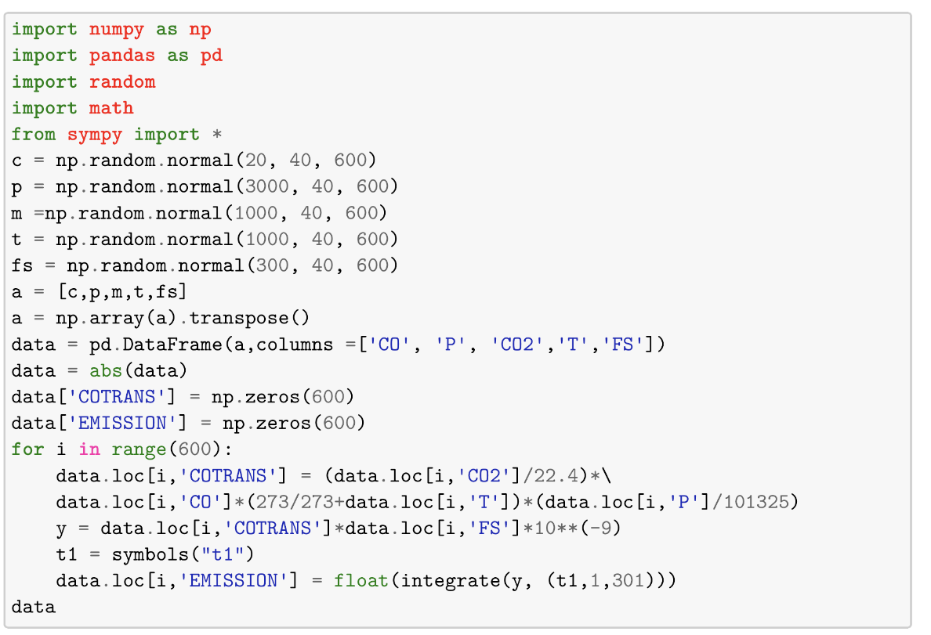
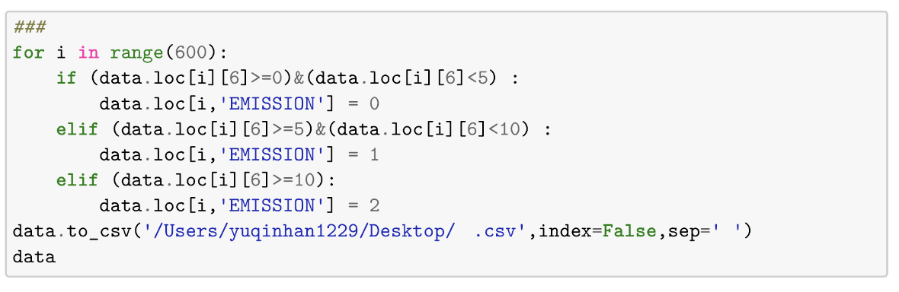
Solution-
Module 1 - Advanced Technology
01
02
Data Preprocessing
Website & APP
Calculation of carbon emissions based on existing technology.
C+- platform
5G
14

Slide 15

Solution-
Module 1 - Contents of the plan
Module 01
Required options(2) + Free options(4)
Customized service
Deep learning
Conduct deep learning on the carbon emission data with R&D team
Dynamic monitoring system
Provide a real-time monitoring system for carbon emissions
Free options
Required options
Cutting-edge technology
Further implementation of CCUS technology
Carbon emission reduction plan
Periodic maintenance suggestions Fuel substitution suggestions Intelligent power suggestions
CCUS suggestions
Training service
Provide training classes based on carbon neutralizes knowledge to employees
Expert consultation
As an intermediary, enterprises and experts can be linked to consult on professional issues
15

Slide 16
Solution-
Module 2 - Carbon Minus Coin project
Carbon Minus Coin project
Two aspects:
·the company's functional office and management
·the surrounding community low-carbon life
PLATFORM
A series of
digital technology
Advocate low-carbon emission reduction behavior
energy conservation and emission reduction
COMMUNITY
16

Slide 17
Solution-
Module 2 - Concrete content
Carbon Minus Coin project
Inside:
·paperless office
· take public transportation
· save electricity
Outside：
The platform launched carbon Minus Coin project
Exchange plant seedlings,
shopping bags,
LED energy-saving lamps...
Coin+5
Private car in parking space for 24 hours continuously
Coin +10
Employees and residents accumulate CMcoins Exchange them for public welfare products
Do not use plastic bags when shopping in the community supermarket
Coin +10
The lowest per capita electricity cost is in the top 10 percent of the community
Coin+15
17

Slide 18
PART 4
Business Analysis
18

Slide 19
Business Analysis-
PEST Analysis
Political
Economic
Double carbon commitment of the Chinese government made the government limit the carbon emissions of enterprises
The national carbon emission trading market was established, excess carbon emission rights can be sold for profit
Social
Technological
Use the carbon factor method to calculate the carbon emissions
High-end technologies such as big data,AI,machine learning
Many carbon emission detection instruments on the market
People advocate authority,and the services provided by expert teams can be favored by enterprise leaders
19

Slide 20
Business Analysis-
SWOT Analysis
SWOT Analysis
First-mover advantage
Application of advanced technology
Monitoring in real time
High expert team salary and scientific research cost
Inadequate effectiveness and accuracy at present
S
W
Hard targets for enterprise emission reduction
Few existing competitors
Possibility of government support
Losses at the initial stage of product launch
Competitors launch homogeneous services to occupy market share
O
T
20

Slide 21
Business Analysis-
Porter Five Forces
BUYERS
In the savage growth stage, suppliers rely on the trust of buyers, so buyers have strong bargaining power.
When more competitors appear,
the bargaining power of buyers will increase
on the whole, but the bargaining power
of high-quality suppliers is expected to decrease.
Porter Five Forces
POTENTIAL NEW ENTRY
New suppliers have lower prices and more innovative content, and the platform may cannibalize the existing market share.
New monitoring models driven by new technologies may wash out existing models and cause industry reshuffle.
SUBSTITUTES
· There are few alternatives to the platform model.
· The combination of online and offline Internet platform model is expected to be the general trend.
COMPETITIVE RIVALRY
SUPPLIERS
In the early stage, customers lack trust and suppliers have weak bargaining power.
In the later stage, the demand of power enterprises for high-quality CO2 monitoring platform increases, but the homogenization is serious, and the platform with mature technology comes to the forefront.
Existing platforms use 4G and IoT technology
Our company uses
5G & personalized daily carbon emission detection
links with the community
The precision, complexity and operability of monitoring technology determine the competitiveness of enterprises. Perfect and mature technology can occupy a large number of market shares.
21

Slide 22
Business Analysis-
4P Analysis
Product Strategy
Distribution Strategy
Carry out product portfolio, provide diversified one-stop services, control each link of user production, meet multiple needs of users.
Follow up strategy to keep up with strong competitors in the industry
Face to face negotiation and business users, in the form of a commercial contract.
According to the needs of users to provide corresponding services, sometimes to the location of the enterprise site visit
Pricing Strategy
Promoting Strategy
Adopt differential pricing strategy.In the expert consultation sector, flexible pricing strategy is adopted.
In the early stage of platform operation, adopt penetration pricing strategy.After forming economies of scale, turn to satisfaction pricing strategy.At the same time, the platform will adopt the strategy of combination pricing
Email marketing - Targeting potential business users.
Impact marketing - Conduct internal pilot through expert matchmaking.
Social media Marketing - Regularly post high quality content on social media
22

Slide 23
PART 5
Development Program
23

Slide 24
Financial Analysis
Developmet Program-
Basic financial assumption
Investment source
capital investment
RMB 600,000
VAT will be payable at a rate of 13% of the selling price
01
02
In the third year of the establishment of the company to consider 15% of the company's net profit dividends
Unit: Ten thousand Yuan
24

Slide 25
Risks & Countermeasures
Developmet Program-
Risk Assessment & Countermeasures
 | Technical | Management | Financial | Other
Risks | The similar new technologies | Operator's inefficient management | Insufficient funds & capital turnover | Policy adjustment
 | Download security risks | Talent loss | Weak legal consciousness & Invalid contract | Emergency
Measures | Machine learning & Big data | Improve the management system | Financial risk monitoring system .etc | Crisis management consciousness
 | Security monitoring system | Talent reserve mechanism | In depth investigation | Analyze the specific situation
25

Slide 26
Developmet Program
Development Program
Overall strategies
· Expand outward, bring out the full potential inward
· Achieve great leap growth
· By 2030 company sales target:30%-40% increase
· The total annual revenue is expected to exceed 450,000 yuan
Improve the technology-centered enterprise innovation system
Strengthen capacity building for new types of human resources
· Build characteristic brand culture
· Condense enterprise core values
Perfect sales system
Expand overseas market
Global Oriented
26

Slide 27

Thank you!
Contact:
XXXXXXX (CEO of C+-)
Mobile: XXXXXXXXXX
27

